Slide 1




Ingles Aplicado a las TIC´s
MODULE 1 – LESSON 7

Slide 2

LET’S REVIEW!

Slide 3

PALABRAS ESTRUCTURALES
DETERMINANTES:
Each of these three types of users has different use of the system so each of them has their own requirements.
PALABRAS DE ENLACE
The restaurant owners will not use the mobile application but the web portal instead.
PRONOMBRES
PROPOSICIONES
There they will manage the information about their restaurant.

Slide 4
VERBOS AUXILIARES
BE:
The Internet is now the most significant medium of entertainment.
Electronic commerce is fast becoming an important component…
The Internet connection is also a constraint for the application.
HAVE
Consumers have information on products and services at their fingertips.
Software Development methodologies have incorporated user feedback in…
DO
It did both instantly, before completing several other tasks.
What does a Software Developer do?
..individual team members do not have all the knowledge required…

Slide 5
VERBOS MODALES /DEFECTIVOS
BRINDAN CIERTO SIGNIFICADO. NO PUEDEN EXISTIR POR SI SOLOS.
CAN / COULD / MAY / MIGHT (PROBAPILITY/POSSIBILITY)
WILL / WOULD (FUTURE/ CONDITION IDEA)
MUST / HAVE TO / OUGHT TO / SHOULD (DUTY)
All of them can understand and update.
The software could be damaged.
This information will act as the basis for the search results displayed to the user.
Board-designated committees, should formally approve project methodologies…
We have to update the system.
Software developers must mantain a constant state of learning.

Slide 6
ESTRUCTURAS DE TRADUCCION

Slide 7
VOZ PASIVA
TODA LA ATENCIÓN ESTA CENTRADA EN EL OBJETO.
BE + PASADO PARTICPIO
Since the database is shared between both applications…
BE + PASADO PARTICIPIO + BY
The mobile application is constrained by the system interface to the GPS navigation system within the mobile phone.

Slide 8
TO
PREPOSITION
INFINITIVE
TO + SUSTANTIVO
TO THE CINEMA
TO THE BOY
TO THE COMPUTER
LO TRADUCIMOS COMO A/AL
TO + VERBO EN INFINITIVO
TO CREATE
TO ELABORATE
TO USE
LO TRADUCIMOS COMO PARA/A
O SOLO EL INFINITIVO.

Slide 9
VERBS AT THE BEGGINING
Sign in to the Zoom web portal.
Click Meetings, and click Schedule a Meeting.
Select the meeting options. Note that some of these options might not be available if they were disabled and locked to the off position at the account or group level. Topic: Enter a topic or name for your meeting. ...
Save to finish.
PODEMOS TRADUCIR ESTAS ESTRUCTURAS DE MANERA FORMAL, INFORMAL O IMPERSONAL.

Slide 10
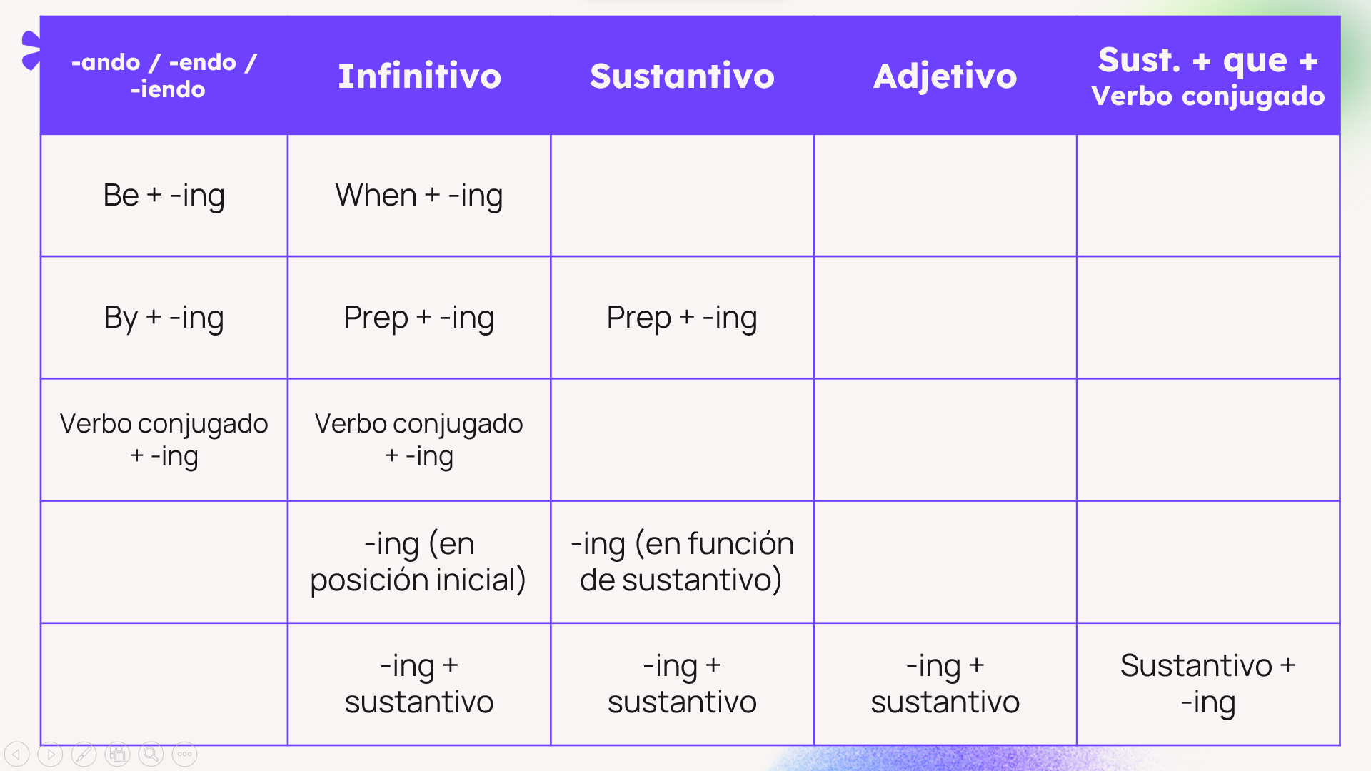
-ING FORMS

Slide 11
LET’S PLAY
UP & UP - COLDPLAY

Slide 12
ORACIONES IMPERSONALES
ESTAS ORACIONES NO TIENEN UNA FRASE NOMINAL QUE ACTÚE COMO SUJETO
IT
THERE
CUANDO ES IMPERSONAL, NO LO TRADUCIREMOS
IT IS WORTHWHILE NOTING THAT THE TERM IT IS…
THERE + BE = HABER. EL TIEMPO SE MODIFICARÁ DE ACUERDO A “TO BE”
THERE ARE SEVERAL NEW SYSTEMS TO TRY.

Slide 13
ESTRUCTURAS CONDICIONALES
CONTIENEN LA PALABRA “IF” QUE TRADUCIREMOS COMO “SÍ”
CASO 0
CASO 1
PRESENTE + PRESENTE
IF I HEAT ICE, IT MELTS
PRESENTE + FUTURO
IF I WORK HARD, I’LL EARN MUCH MONEY.
CASO 2
CASO 3
PASADO + WOULD
IF I WORKED, I WOULD HAVE MONEY
PARTICIPIO + WOULD HAVE
IF I HAD GONE TO THE PARTY, I WOULD HAVE SEEN HER

Slide 14






APPS DE TRADUCCIÓN
TripLingo
Microsoft Translator

Slide 15

Let´s Practice

Slide 16
TRANSLATE AND FIND MISTAKES
Evolving A New Model (SDLC Model-2010) For Software Development Life Cycle (SDLC)
Structured project management techniques (such as an SDLC) enhance management’s control over projects by dividing complex tasks into manageable sections. A software life cycle model is either a descriptive or prescriptive characterization of how software is or should be developed.
Desarrollando un nuevo modelo (SDLC Model-2010) para el ciclo de vida de desarrollo de software (SDLC)
Las técnicas de gestión de proyectos estructuradas (como un SDLC) mejoran el control de la gestión de los proyectos al dividir tareas complejas en secciones manejables. Un modelo de ciclo de vida de software es una caracterización descriptiva o prescriptiva de cómo es o el software debe ser desarrollado.

Slide 17
TRANSLATE AND FIND MISTAKES
But none of the SDLC models discuss the key issues like Change management, Incident management and Release management processes within the SDLC process, but it is addressed in the overall project management. In the proposed hypothetical model, the concept of user-developer interaction in the conventional SDLC model has been converted into a three dimensional model while comprising the user, owner and the developer.
Sin embargo, ninguno de los modelos de SDLC aborda cuestiones clave como la gestión de cambios, la gestión de incidentes y los procesos de gestión de versiones dentro del proceso de SDLC, pero esto es abordada en la gestión general del proyecto. En el modelo hipotético propuesto, el concepto de interacción usuario-desarrollador del modelo SDLC convencional ha sido convertido en un modelo tridimensional mientras incluye al usuario, propietario y desarrollador.

Slide 18
TRANSLATE AND FIND MISTAKES
The ―one size fits all approach to applying SDLC methodologies is no longer appropriate. We have made an attempt to address the above mentioned defects by using a new hypothetical model for SDLC described elsewhere. The drawback of addressing these management processes under the overall project management is missing key technical issues pertaining to the software development process, that is, these issues are talked about in the project management at the surface level but not at the ground level.
El enfoque de “talla única para todos” para aplicar metodologías SDLC ya no es adecuado. Hemos intentado abordar los defectos mencionados anteriormente mediante el uso de un nuevo modelo hipotético para SDLC descrito en otra parte. El inconveniente de abordar estos procesos de gestión bajo la dirección general del proyecto es que faltan cuestiones técnicas clave relacionadas con el proceso de desarrollo de software, es decir, estas cuestiones son abordadas en la gestión del proyecto a nivel superficial pero no a nivel básico.

Slide 19
BEFORE WE FINISH
HABLEMOS DELTRABAJO PRACTICO DE CERTIFICACIÓN DEL NIVEL 1:
ES MUY SENCILLO DE REALIZAR
TIENEN DESDE EL 10/07 AL 16/07 PARA COMPLETARLO Y ENVIARLO.
DURANTE ESA SEMANA, LAS CLASES SINCRONICAS SE DICTARAN CON NORMALIDAD PERO FUNCIONARAN COMO CLASE DE CONSULTA.
PEDEN ENTRAR Y SALIR DEL DOCUMENTO LAS VECES QUE NECESITEN.
UNA VEZ ENVIADO, YA NO SE PODRÁ VOLVER A INGRESAR AL MISMO. https://forms.office.com/r/FNj5uPsmLZ

